Slide 1
Plum Assignment for Data Analyst Position
Name:Yash Vachhani
Email:vachhaniyash009@gmail.com
Linkdin: https://www.linkedin.com/in/yash152/
Github: https://github.com/yash76373678
Mobile No:8238073780
Address:Bangalore

Slide 2
Problem Statement
How are the efficiency numbers looking like? Can you share your views?
Which groups are quick slow etc. Create table + relevant charts.
What type of tickets are taking the most time to resolve? Create a table + relevance charts.
Create a different type of data rights weekend info from this data.

Slide 3
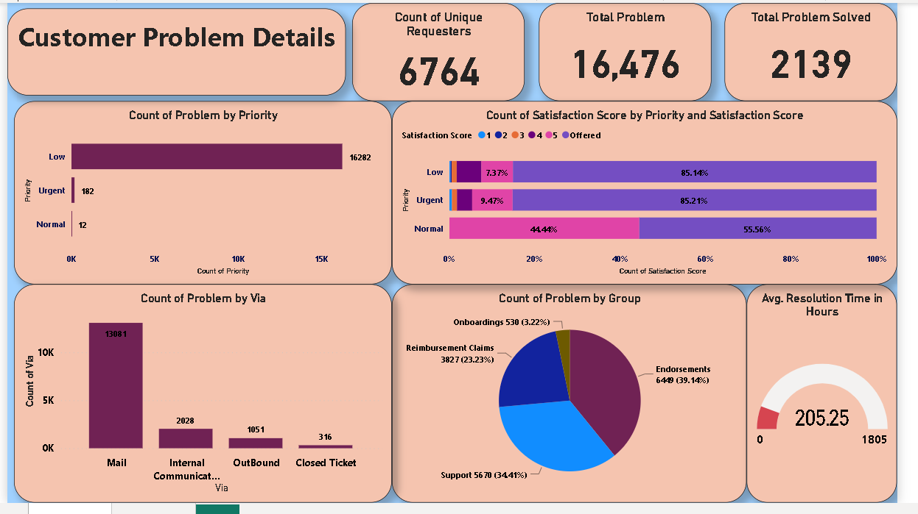
Overall Dashboard

Slide 4
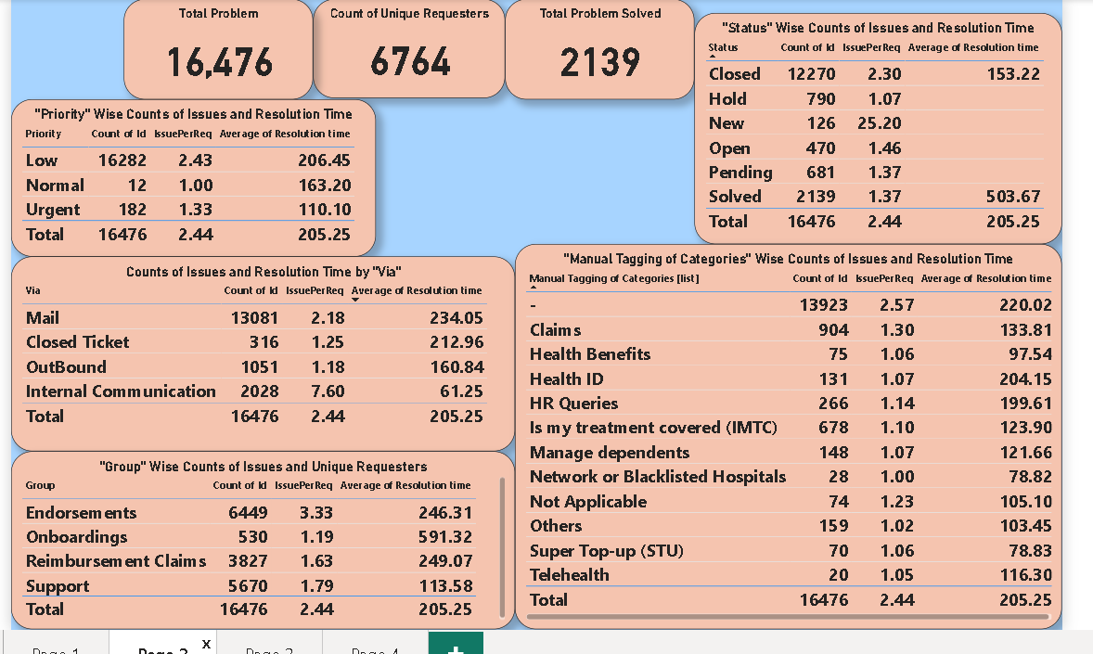
Categorical Analysis

Slide 5
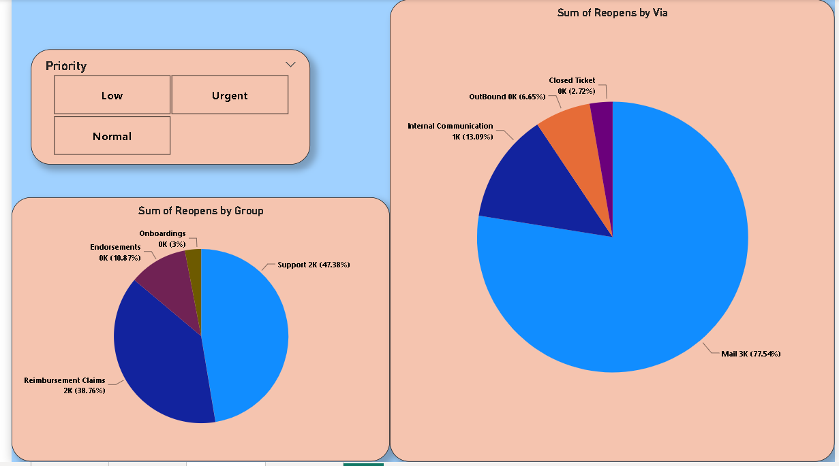

Slide 6
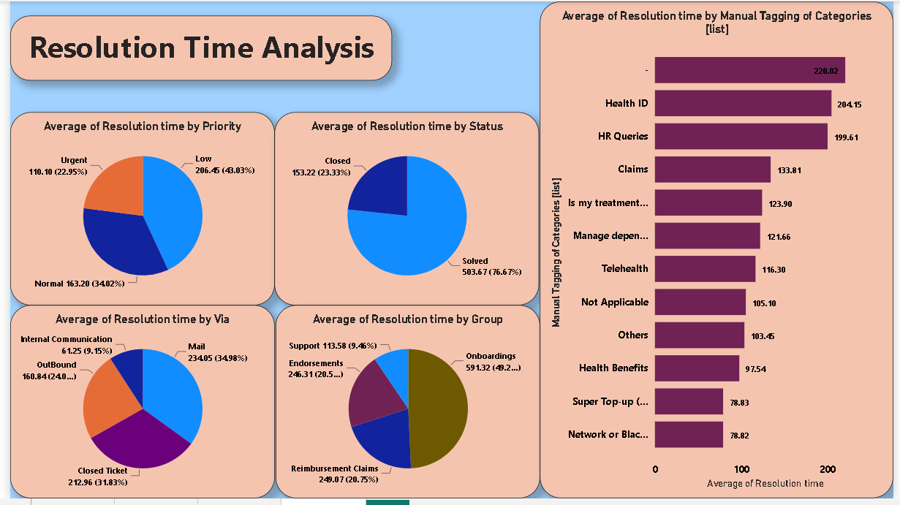

Slide 7
Insight
There are a total of 16,476 problem requests, with 6,764 unique request IDs. Out of these, 2,139 problems have been successfully solved.
Notably, 98% of the problems are categorized as low priority
Additionally, it is observed that the majority of the problems are requested via email.
“Network or Blacklisted Hospitals”, “Category”, “Health Benefits”, “Is My treatment Covered (IMTC)” and “Others” have nearly similar resolution time in low priority tickets whereas tickets which were never tagged Untagged has highest resolution time for low priority ticket.
“Internal communication” is Fastest and “Mail” is Slowest route of solving ticket.

Slide 8
Efficiency Numbers as Solved Tickets
1.Not Applicable
2.Health ID
3.HR Queries
4.Super Topup
5.Health Benefits
6.Network or Blacklisted Hospitals
7.Telehealth
8.Others
9.IMTC
10.Manage dependents

Slide 9
Conclusion
Quickest and Slowest Priority tickets :
“Urgent” priority tickets which where solved has more than double resolution time as compared to time taken by avg of all total urgent priority tickets resolution time.

Slide 10
About Group Conclusion
Focus on Support Group: Given that around 80% of tickets come through emails, prioritize increasing the workforce in the Support group, which receives the majority of these requests.
Address Ticket Categories: Identify and prioritize ticket categories, especially the prevalent "Over under cleans" and claim categories, to align the workforce accordingly.
Reevaluate Ticket Prioritization: With 98.82% of tickets categorized as low priority and a low solving rate (12.47%), reassess and potentially reprioritize tickets for better efficiency.
Reduce Ticket Reopenings: Recognize the high rate of ticket reopenings (only 6,764 distinct IDs out of 16,476 total tickets) and implement strategies to reduce this reopening rate.
Manage Reopening Across Groups: Address the substantial reopening rates in the Support and Reimbursement Claims groups, aiming to improve issue resolution and decrease workload.
Enhance Mail Route Management: Given that 77.54% of reopening tickets are via email, ensure meticulous maintenance of the "Mail" route to handle the surge in reopening requests effectively.
In summary, the company should bolster the Support group, strategically address ticket categories, reconsider prioritization, reduce reopening rates, and optimize email management to efficiently handle the current rush.

Slide 11
About Satisfication Score
Group-specific Satisfaction: Support group shows Satisfaction Scores (1 to 5), while Reimbursement Claims, Onboarding, and Endorsements lack recorded scores, signaling a need for attention in these areas.
Priority-based Satisfaction Trends: Low priority tickets cover a wide range of satisfaction scores, whereas normal tickets predominantly receive a rating of 5. Urgent priority tickets exhibit positive trends, with 64% getting a rating of 5 and 24% with a rating of 4, indicating efficient resolution.
Low Priority Ticket Satisfaction Breakdown: Low priority tickets show positive satisfaction scores, with 50% resolved with a rating of 5, 39.90% with a rating of 4, and 8% with a rating of 3. Satisfaction Score
Availability: Noteworthy is the absence of Satisfaction Scores for the majority of data, emphasizing the need for a more comprehensive and widespread collection of satisfaction feedback.
Holistic Satisfaction Approach: The company should prioritize obtaining Satisfaction Scores for all tickets, irrespective of their status, to gather a complete understanding of customer satisfaction and identify areas for improvement.
In conclusion, while the Support group performs well in terms of satisfaction, the company should extend efforts to gather scores across all groups and statuses for a more comprehensive evaluation and improvement strategy.

